Slide 1
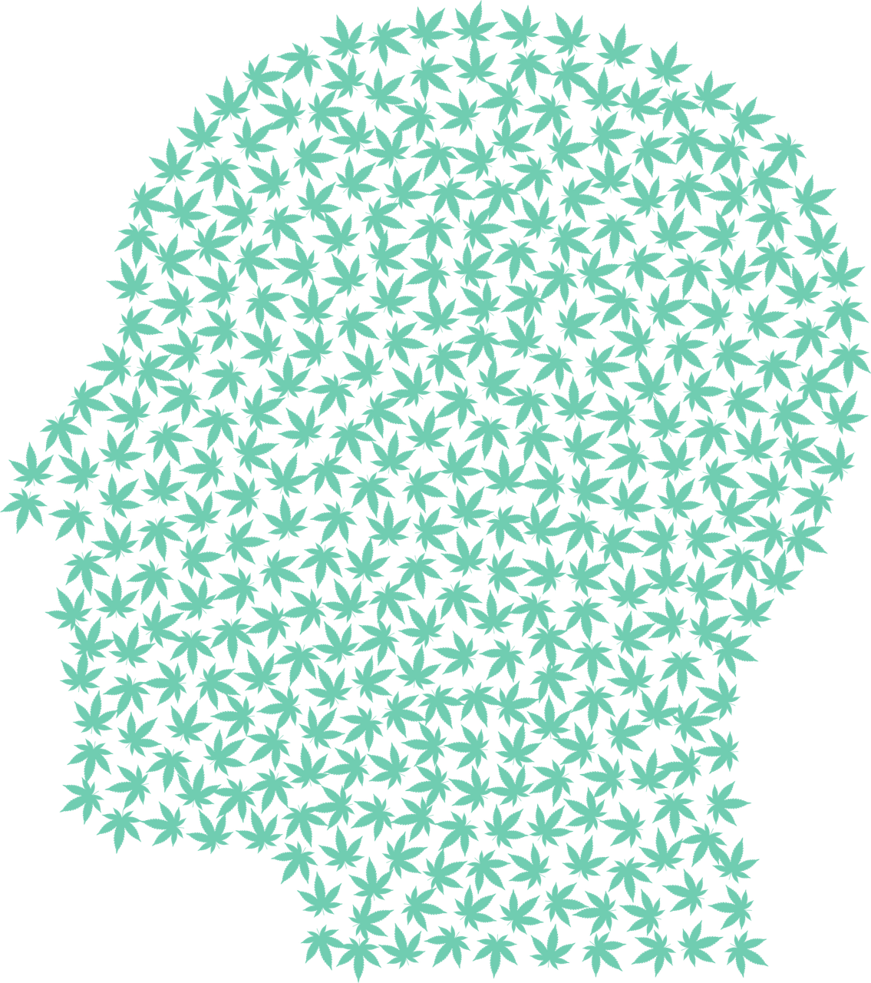
The “New” Marijuana & Today’s Youth
Includes Updates as of July 2021
Following Legalization of Adult Use
Notes:
With the possibility that CT will make marijuana legal for recreational purposes this year, we want to make sure everyone is educated in order to be well informed in discussions about state policy.

Slide 2
Content
The New Marijuana
How Marijuana Affects the Developing Brain
Use and Perception of Harm in CT Teens
New Law
Resources
Notes:
Today’s marijuana often looks like the picture on the top. Through chemical processes, the psychoactive ingredient in the plant—THC—is extracted as oil and/or condensed into forms referred to as dabs, wax or shatter. The result is a very high strength drug without the other parts of the plant.

Slide 3
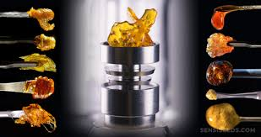
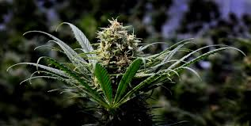
1. The New Marijuana
versus
Notes:
Today’s marijuana often looks like the picture on the top. Through chemical processes, the psychoactive ingredient in the plant—THC—is extracted as oil and/or condensed into forms referred to as dabs, wax or shatter. The result is a very high strength drug without the other parts of the plant.

Slide 4
CBD vs THC
CBD is not an intoxicant. THC is the psychoactive ingredient in marijuana.
https://www.foodanddrinkresources.com/hemp-vs-cbd-vs-marijuana-comparison-chart/ 2019
Notes:
Refer back to Surg Gen’l video:
THC causes the euphoria and intoxication of “getting high”. It also produces anxiety, agitation, paranoia, and psychosis.
CBD – does not cause intoxication though long term effects are unknown. However, CBD on the market often contains THC. It is *unregulated*
https://www.foodanddrinkresources.com/hemp-vs-cbd-vs-marijuana-comparison-chart/

Slide 5
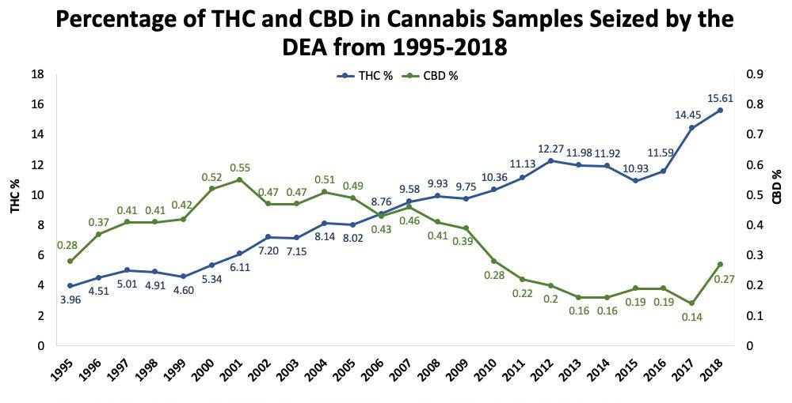
Marijuana has been bred for THC potency over time
https://www.hhs.gov/surgeongeneral/reports-and-publications/addiction-and-substance-misuse/advisory-on-marijuana-use-and-developing-brain/index.html
Notes:
As Surg Genl said, the marijuana available today is much stronger than previous versions. The THC concentration in commonly cultivated marijuana plants has increased three-fold between 1995 and 2014 (4% and 12% respectively)4. As the THC content has increased, the CBD content has decreased. It’s not the original plant any more. (Also, if this graph starts went back to the 70s, the THC levels were around 1%.)
This is an industry. Growers make a LOT of money and have a lot of clout.

Slide 6
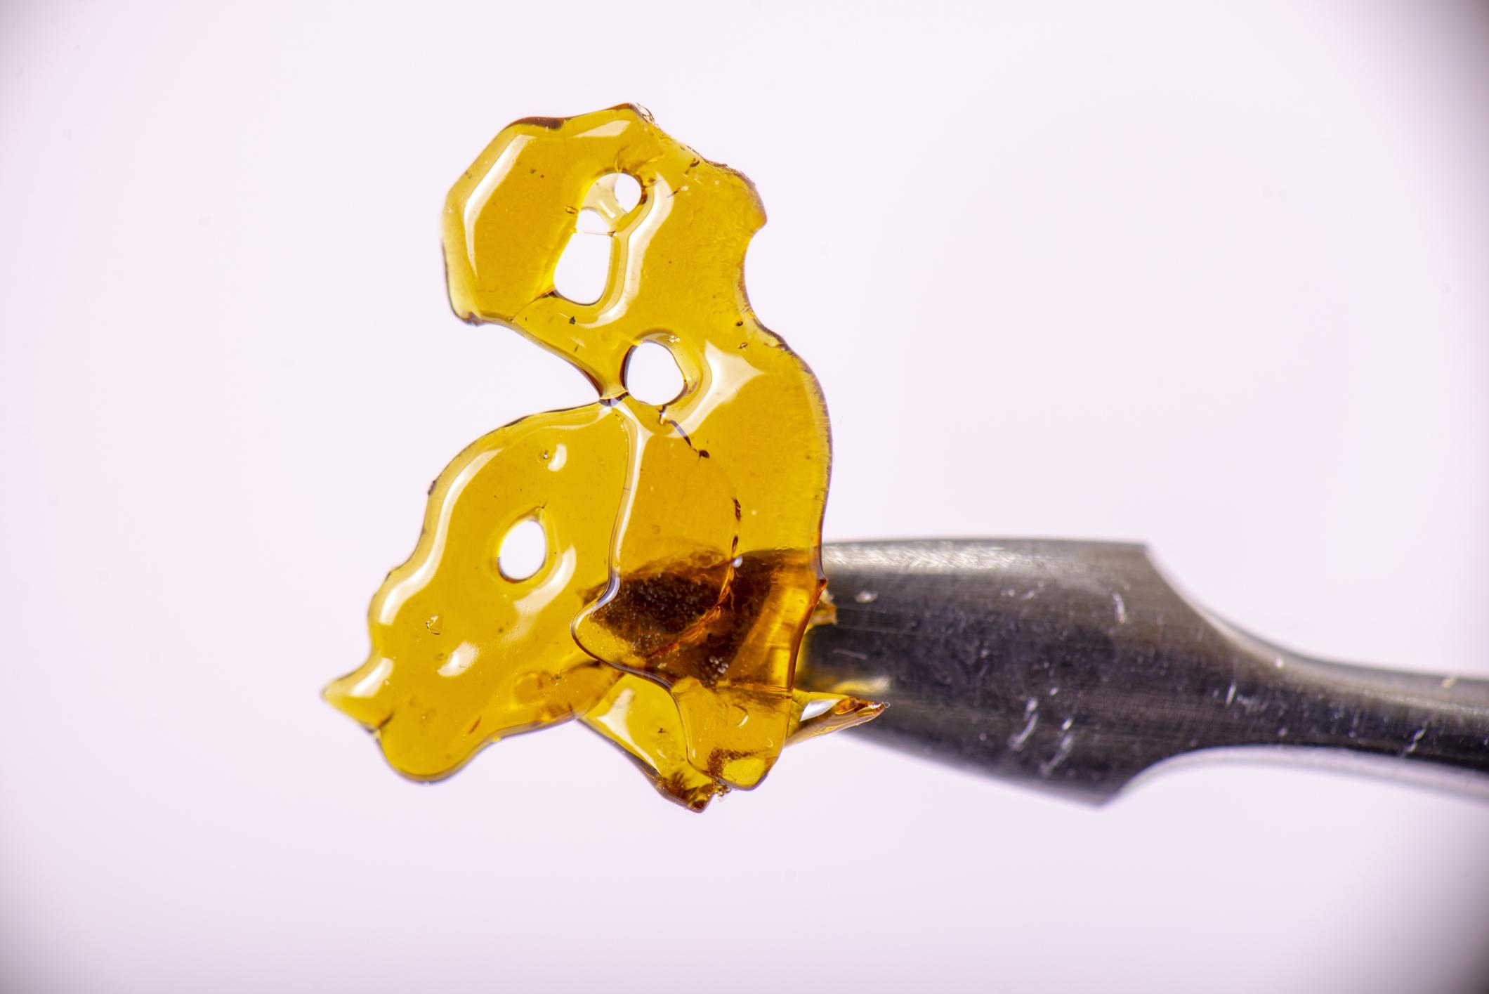
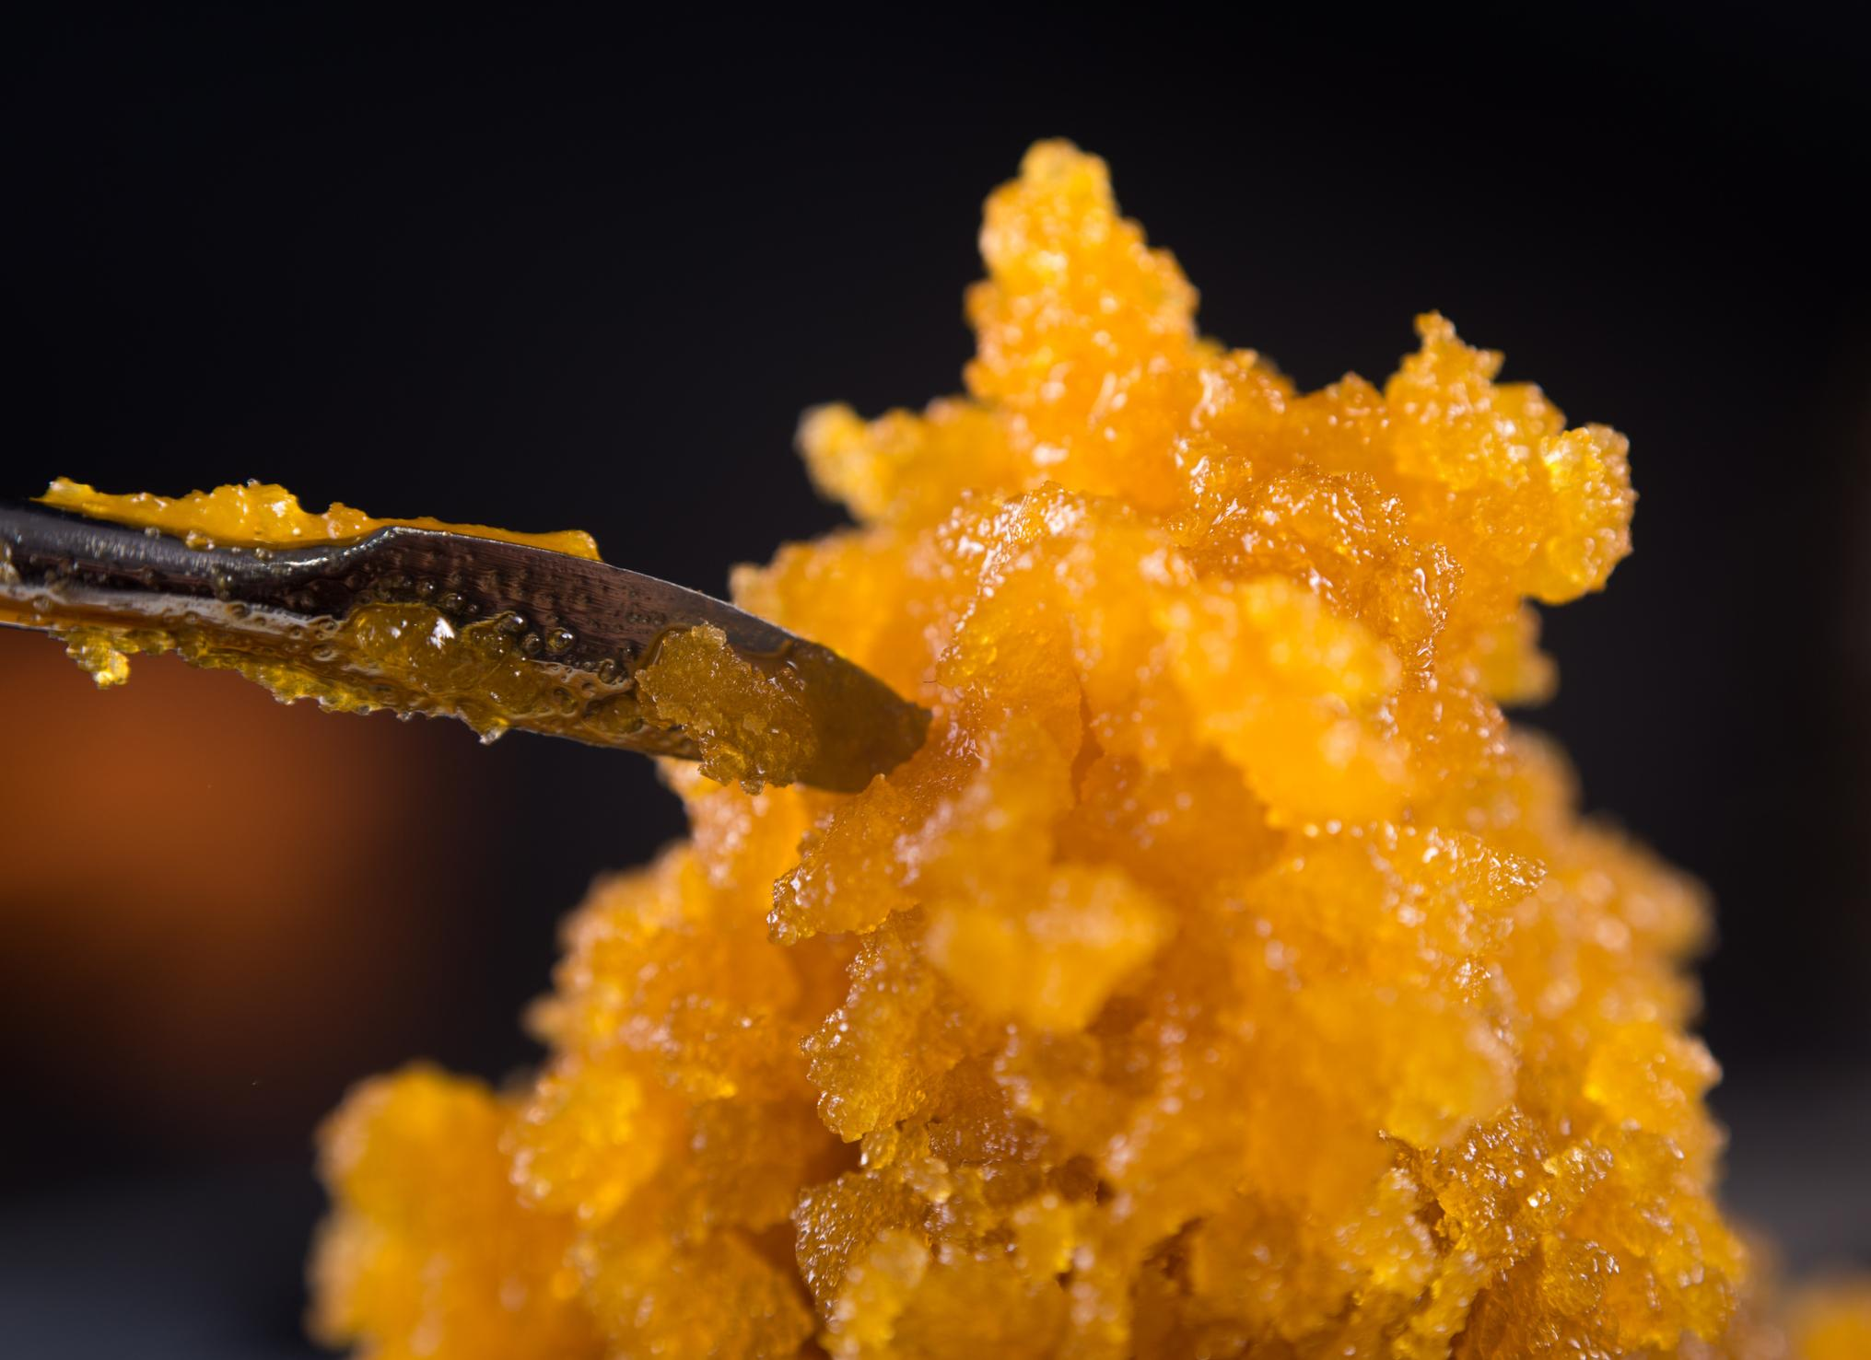
High-potency marijuana is readily available
Marijuana dispensaries carry concentrations up to 23% THC
Concentrates (hash oil, budder, wax, shatter…) can contain 3-5x more THC than the plant itself… up to 76% THC
In 2020, more than ½ of US high school seniors who used marijuana vaped it in concentrated form
https://www.hhs.gov/surgeongeneral/reports-and-publications/addiction-and-substance-misuse/advisory-on-marijuana-use-and-developing-brain/index.html
Notes:
Marijuana available in dispensaries in states that have legalized medical or recreational marijuana has average concentrations of THC between 17.7% and 23.2%5.
In addition, concentrated products, commonly known as dabs or waxes, are far more widely available to recreational users today and may contain [between 23.7% and] up to 75.9% THC6. (Some government sites say up to 90%!) These products are produced through chemical processes—another reason “weed” today isn’t at all natural.
Slide 31: 58% of the 12th graders who reported using marijuana in Dec 2020 used it by vaping.
Smoking extracts and resins from the marijuana plant with high levels of THC is on the rise. There are several forms of these extracts, such as hash oil, budder, wax, and shatter. These resins have 3 to 5 times more THC than the plant itself. Smoking or vaping it (also called dabbing) can deliver dangerous amounts of THC and has led some people to seek treatment in the emergency room. There have also been reports of people injured in fires and explosions caused by attempts to extract hash oil from marijuana leaves using butane (lighter fluid).

Slide 7
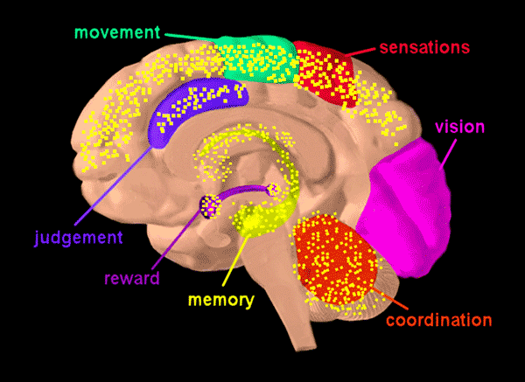
2. How Marijuana Affects the Developing* Brain
Parts of the brain affected by THC:
Graphic: NIDA
*The human brain is not fully mature until the person is in their mid to late 20s.
Notes:
THC is psychoactive, which means it affects the brain in the areas shown here (read). Since the brain is undergoing major development up until a person is in their mid to late 20’s, THC puts that development at risk.

Slide 8
U.S. Surgeon General Warning on Marijuana Use in Adolescence
“Frequent marijuana use during adolescence is associated with changes in the areas of the brain involved in attention, memory, decision-making, and motivation.”
“Earlier initiation of marijuana use is associated with an increased risk of developing addiction.”
Jerome Adams, MD,
August 30, 2019
Notes:
In 2019, The U.S. Surgeon General issued a warning about the potential health risks of marijuana use in adolescence. The warning states that no amount of marijuana use during adolescence is known to be safe. He highlighted the effects on the areas of the brain we just saw, as well as the increased risk of addiction.
[if want to show the 3 minute Q&A with him at this point: https://youtu.be/OYZvUDbzUk8]

Slide 9
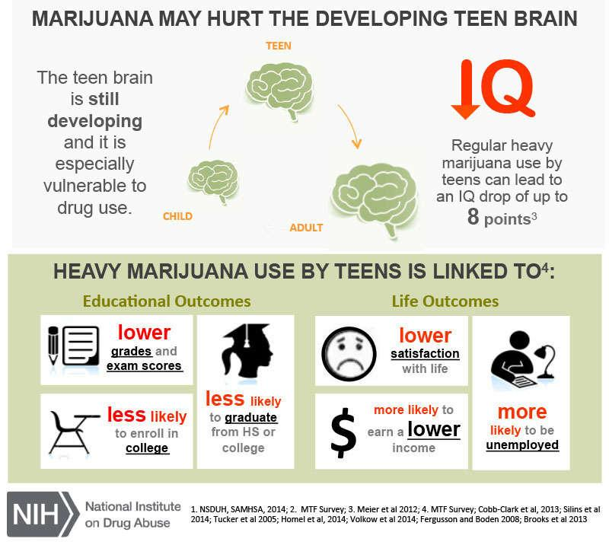
Risk of losing IQ points
Notes:
IQ loss of 6-8 points among heavy users who start as teens – study from New Zealand
[Same study found that people who started using MJ in their 20s, when brain was more mature, did not have that same loss]

Slide 10
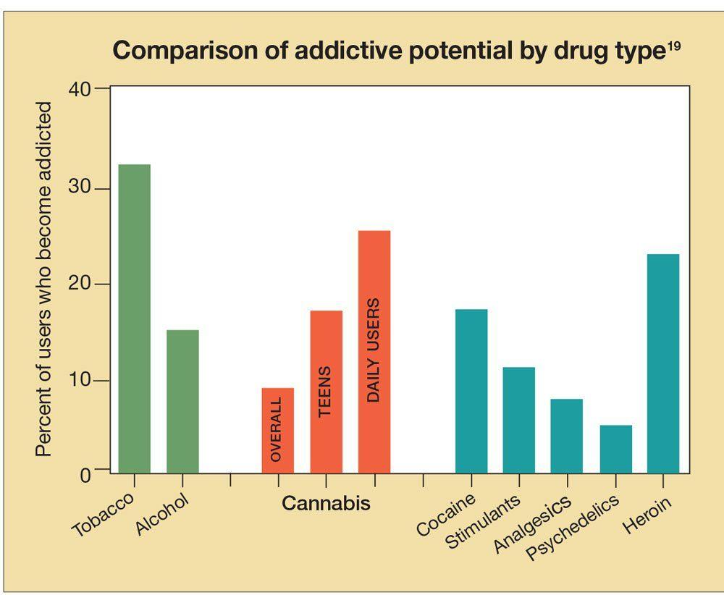
Potential for addiction
Teen addiction risk increases based on THC potency:
4.9% THC --> 1.88x risk
12.3% THC --> 4.85x risk
https://www.psychiatrictimes.com/view/cannabis-use-young-adults-challenges-during-transition-adulthood 2015
Notes:
https://www.psychiatrictimes.com/view/cannabis-use-young-adults-challenges-during-transition-adulthood 2015
Graph shows that for teens, MJ is more addictive than alcohol. For daily users, it’s more addictive than heroin!
[defining characteristics of addiction = tolerance, withdrawal]
Likelihood of becoming addicted is linked to age of use; potency; frequency
Among teen users, increased potency increased risk:
4.9% THC 🡪 1.88x risk of 1st CUD symptom a year later
12.3% THC 🡪 4.85x risk of 1st CUD symptom a year later
https://www.sciencedirect.com/science/article/abs/pii/S0376871618308202?via%3Dihub

Slide 11
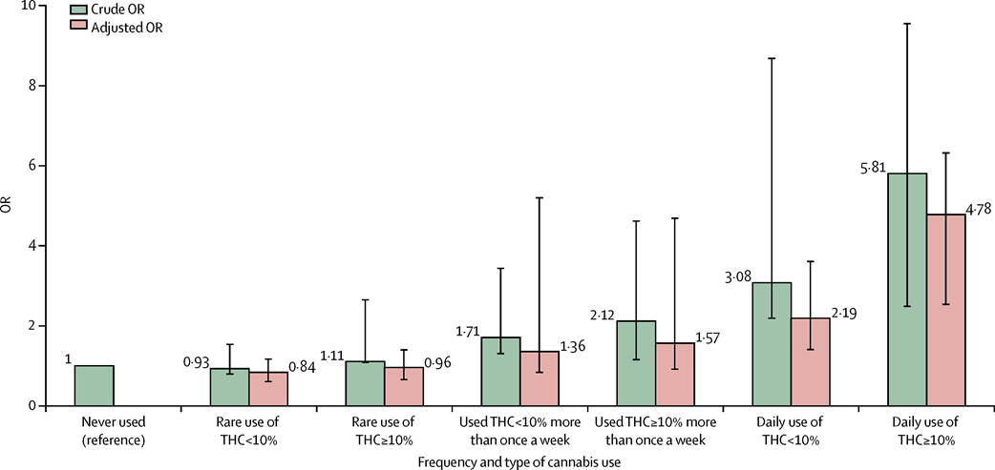
Risk of psychotic disorder
The odds of developing a psychotic disorder rise as frequency and potency of THC increase
The Lancet, March 19, 2019 https://doi.org/10.1016/S2215-0366(19)30048-3
Notes:
According to a 2021 CT DPH communication: Between 2016 to 2019, CT hospital admissions for marijuana intoxication increased 491% for youth up to age 18 and 391% for people ages 19 and older. The total number in 2019 was 937 people. During the same period, psychosis increased 300% for hospital admissions for mental illness with marijuana use.
Explanation of graph:
Crude and fully adjusted Odds Ratios (Ors) of psychotic disorders for the combined measure of frequency plus type of cannabis use in the whole sample
Crude ORs are adjusted only for age, gender and ethnicity. Fully adjusted ORs are additionally adjusted for level of education, employment status, and use of tobacco, stimulants, ketamine, legal highs, and hallucinogenics. Error bars represent 95% Confidence Intervals.
The odds of psychotic disorder among daily cannabis users were 3·2 times higher than for never users, whereas the odds among users of high-potency cannabis were 1·6 times higher than for never users. Starting to use cannabis by 15 years of age modestly increased the odds for psychotic disorder but not independently of frequency of use or of the potency of the cannabis used. These measures of extent of exposure did not interact with each other, nor did they interact with the sites. This lack of interaction between degree of cannabis use (ie, daily use of cannabis or use of high-potency cannabis) and site might reflect insufficient power in our study; however, it could also indicate that although the magnitude of the effect might vary depending on the degree of cannabis use, there is a consistent effect of daily use and use of high-potency cannabis on the ORs for psychotic disorders across all study sites.
Interpretation (final section of article): Differences in frequency of daily cannabis use and in use of high-potency cannabis contributed to the striking variation in the incidence of psychotic disorder across the 11 studied sites. Given the increasing availability of high-potency cannabis, this has important implications for public health.
Source: The contribution of cannabis use to variation in the incidence of psychotic disorder across Europe (EU-GEI): a multicentre case-control study Marta Di Forti, Diego Quattrone, et al. Lancet Psychiatry 2019; 6: 427–36 Published Online March 19, 2019 http://dx.doi.org/10.1016/ S2215-0366(19)30048-3

Slide 12
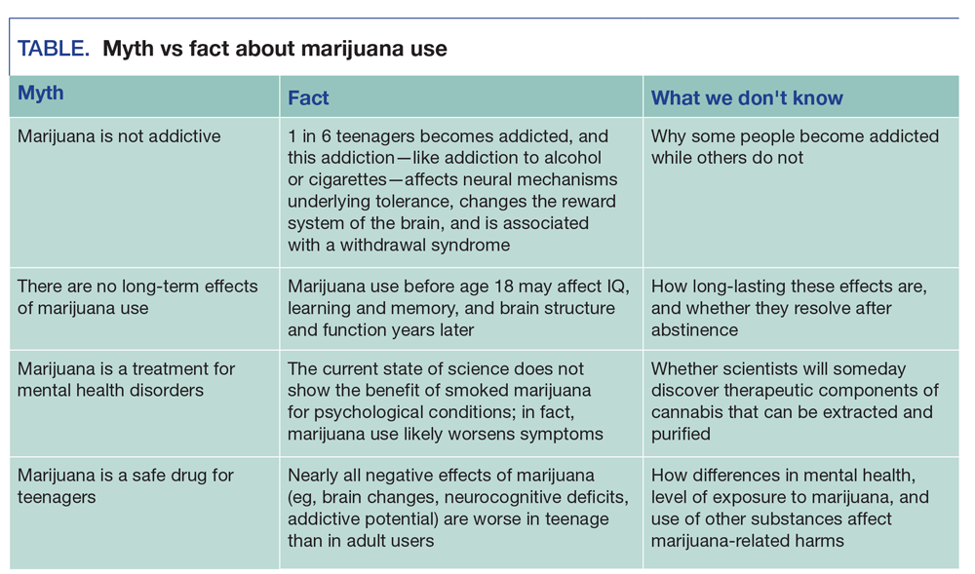
Myths & Facts about Teen Marijuana Use
https://www.psychiatrictimes.com/view/cannabis-use-young-adults-challenges-during-transition-adulthood 2015
Notes:
https://www.psychiatrictimes.com/view/cannabis-use-young-adults-challenges-during-transition-adulthood 2015
Mention that kids who use weed regularly think it’s helping them b/c when they stop using it, they feel anxious.
But that anxiety may be caused by the drug (withdrawal). More important to figure out why they’re anxious at all and find
Positive coping skills.

Slide 13
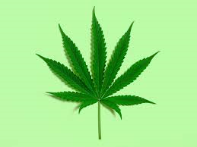
3. Use & Perceptions of Harm in CT Teens

Slide 14
Marijuana Use in CT Teens
In Connecticut and the US, 21.7% high school students currently use marijuana. (YRBS, 2019)
In CT, higher use rates are reported among:
Gay, Lesbian, Bisexual youth (33%)
Hispanic (24%) and White (22%) youth vs Black youth (15.5%)
Boys (22%) vs girls (20%)
Notes:
21.7% of 9th – 12th graders – this is CT and US stat – YRBS 2019
33% of LGB compared to 21% straight
24% Hisp, 22% White, 15.5% Black

Slide 15
PD’s 2021 Local Survey Findings (3 towns in mid Fairfield County)
Current MJ use (during COVID) for all grades (7th-12th) ranged from 4% (city) to 11% (suburb)
Current MJ use (during COVID) among HS seniors ranged from 12% (city) to 25% (surburb)
Teen perception of parental & peer disapproval is lower for MJ than any other substance
Less than 1/2 of HS seniors perceive peer disapproval (only 1/4 at one suburban high school)
Perception of harm is very low (58%-65% think using MJ 1-2x/week is risky – yet that level of use by teens is associated with IQ loss, addiction and psychosis)
Depending on the town, 1/2 to 2/3 of those who vape are vaping marijuana (vs nicotine)
Notes:
Only about ¾ of 7th graders perceive harm
At risk groups: LGBTQ

Slide 16
Findings from State-wide Focus Groups in December 2020
USE
Overall perception that MJ use among some teens has increased during COVID due to increased anxiety
ACCESS
Widely and easily accessible
Access via social media sites (Snapchat) has increased during COVID; school-based access has decreased
PERCEPTION OF HARM
Sense that marijuana use is safe
Used to reduce stress (vs alcohol, used for boredom/social purposes)
FAMILY NORMS
Some permissive parents, more convos about alcohol, lower perception of harm
Notes:
In a recent DMHAS funded project that included conducting 28 focus groups among MS and HS youth and parents of teens there were some overall
Youth believe their peers use marijuana because they are “looking for escapes and can’t leave their house,” alcohol use was more frequently identified as an activity borne from boredom, compared to marijuana use being cited as a coping mechanism for stress and anxiety. And teens drew the connection between stress and anxiety levels increasing due to COVID and “new influxes of people...considering starting marijuana and edibles [because] they...need something to help them cope.” And are increasingly “looking to get high to get away from this, depression and anxiety.”
Many students reported that vaping marijuana was more common than nicotine vaping. “I think people are using marijuana in their vape because it calms them down more than just the normal vape would.” In addition, “alcohol is seen as more social and people smoke marijuana on their own and now that they have more time alone.”
There is also an increasing sense that marijuana use is safe, and a common means to reduce stress.
Some students perceived their parents as permissive around marijuana use. Some also believe, for example, that there may be more conversations with parents around “the dangers of alcohol use than around weed.” Other students reported that they have “heard parents and people say weed isn’t that bad and it doesn’t have a [negative] effect on your body.” They also “know so many parents that smoke” and “see parents at parties using it.” Additional, youth have also seen their parents use marijuana as a method to relieve pain.

Slide 17
4. New Law
Links to:
State cannabis website
Summary of bill
CT Mirror article 6/22
CT Mirror op-ed by retired police officer 6/30
List of recommendations by CT TTASC (statewide prevention group)

Slide 18
PA 21-1 went into effect 7/1/21
POSSESSION
Legal for 21yo+
1.5oz plant material on person+ 5oz locked in home/car; THC caps at 30% (plant), 60% (concentrates)
DUI still illegal
Homegrow for MMJ clients 18yo+ starts 10/21; for anyone 21+ 7/23
SALES
Starting 2022
Advertising is severely restricted
Basic warning required, not detailing specific types of harm to teens, pregnant women (less detailed than alcohol or cigarette labels)
Revenue from 3 sources: sales tax, municipal sales tax, tax based on THC content
PUBLIC CONSUMPTION
Restrictions on consumption in workplaces, hotels, public spaces… All related laws apply equally to cigarettes, vaping & marijuana
Municipalities over 50,000 must have 1 designated outdoor space
Notes:
(1.5 oz plant material or equivalent, 5 oz locked up)
(3 mature+3 immature plants)

Slide 19
Prevention Community’s Concerns regarding the Law
Act disregards the public health concerns. Future efforts should:
Create / strengthen penalties for youth possession
Revisit the caps on THC levels which are not science based. Caps don’t apply to pre-filled vape cartridges
Strengthen product warning labels
Provide for compliance checks around labeling, THC levels, sales to minors
Address online availability
Strengthen laws and enforcement related to drugged driving
Ensure funding for prevention, mental health treatment, and substance use treatment from the beginning
Notes:
(1.5 oz plant material or equivalent, 5 oz locked up)
(3 mature+3 immature plants)

Slide 20
Options for Prevention Coalition Work
Using SAMHSA’s 7 Strategies for Community Change is an effective model that tackles prevention in a multifaceted way:
Gather & disseminate information to build awareness of health risks, current local trends, local conditions (e.g., focus groups, youth survey, environmental scan, media campaigns)
Build skills in youth, parents, teachers, youth services, retailers, law enforcement or other stakeholder groups
Ensure supports (e.g., peer groups, recovery supports, family supports)
Change access (e.g., lock it up campaigns, easier access to treatment)
Change consequences (e.g., recognitions to retailers that are in compliance, automatic referrals to JRB for possession at school)
Modify physical design (e.g., signage, retail outlet density)
Modify policies (e.g., school policies, YSB referrals, state law)
Notes:
Working on video series now
Joined CT’s team for Project ECHO (learning collaborative)

Slide 21
5. Resources
Links to information for parents & teens
Where to go for help
List of research studies & findings

Slide 22
Info & Referrals
Information for parents:
Drugfree.org toolkit: Talk to your Kids about MJ-
https://drugfree.org/wp-content/uploads/2017/02/Marijuana_Talk_Kit.pdf
Drugfreect.org
Information for teens:
Justthinktwice.gov
SAMHSA.gov/marijuana
Health information:
cdc.gov
Drugabuse.gov
CT Access Line for drug treatment:
1-800-563-4086
Treatment in Southwest CT:
www.TheHubCT.org/treatment
Recovery support for teens:
Turningpointct.org/smart
Alateen
SMART Recovery teens
Smart Approaches to Marijuana one-page factsheets:
https://learnaboutsam.org/toolkit/

Slide 23
Risks of adolescent marijuana use
Marijuana use is linked to earlier onset of psychosis in youth known to be at risk for psychotic illness. (McHugh et al, 2017)
Exposure to marijuana in adolescence is associated with an increased risk for later psychotic disorder in adulthood. (D’Souza et al, 2016)
Higher rates of school suspensions and expulsions (Colorado and Washington State, 2018)
Higher rates of car crashes (Colorado and Washington State, 2018)

Slide 24
Risks of adolescent marijuana use
Chronic use is linked to declines in IQ, poor school performance, and increased drop‐out rates that jeopardize professional and social achievements, and life satisfaction. (Meier et al, 2012)
Adolescent marijuana use is associated with other substance use and with abuse of prescription pain medications. (Jones and McCance‐Katz, 2018; Olfson et al, 2017)
People using marijuana before age 18 are 4-7x more likely to develop cannabis use disorder than adults. (Winters and Lee, 2008)

Slide 25
ER visits related to marijuana use increased in Colorado
From 2012 to 2016, 2,567 emergency visits at a Denver hospital were caused by marijuana.
17% of visits for uncontrolled bouts of vomiting, most often from inhaled marijuana.
12% for acute psychosis, where people without a history of mental disorders lose touch with reality. More frequently seen with edibles.
Notes:
March 2019: Annals of Internal Medicine.
Emergency room records from Monte's hospital show a three-fold increase in marijuana cases since the state became the first to allow sales of recreational marijuana in January 2014. Nearly a third of patients were admitted to the hospital, evidence of severe symptoms, Monte said.
In 2012, the ER saw an average of one patient every other day with a marijuana-caused problem. By 2016, the count was two to three per day. That's not enough to swamp the emergency department, Monte said, but it stresses an already burdened system.
In the state-funded study, 2,567 emergency visits at the Denver hospital were caused by marijuana from 2012-2016. Nine out of 10 cases were Colorado residents. Seventeen percent of the visits were for uncontrolled bouts of vomiting. It was most often from inhaled marijuana, not edibles.
Twelve percent of the cases were for acute psychosis, where people without a history of mental disorders lose touch with reality. That was more frequently seen with edibles.
The findings come on the heels of a study published last week that found people who smoked strong marijuana on a daily basis were three times more likely to be diagnosed with psychosis compared with people who never used the drug. Intoxication and heart problems were other common complaints in the Colorado hospital study.

Slide 26
Teen Mortality and Marijuana Use
“Cannabis Use Disorder is significantly associated with an increased risk of nonfatal self-harm, all-cause mortality, and death by unintentional overdose and homicide.”
(Fontanella et al, 2021)
In Colorado…
MJ was the most common substance present in suicides among adolescents aged 10-19. It was present in 30.6% of suicides, compared to 9.7% for alcohol
Source: Roberts, B.A. (2019 June 3). Legalized cannabis in Colorado emergency departments: A cautionary review of negative health and safety effects. Western Journal of Emergency Medicine: Integrating Emergency Care with Population Health.

Slide 27
Studies on impact of cannabis use continue in 2021.
January 19, 2021, Association of Cannabis Use With Self-harm and Mortality Risk Among Youths With Mood Disorders
This population-based cohort study of Medicaid-enrolled youths with mood disorders found that the presence of cannabis use disorder was significantly associated with an increased risk of nonfatal self-harm, all-cause mortality, and death by unintentional overdose and homicide.
Cannabis use disorder is common among adolescents and young adults with mood disorders and is associated with an elevated risk of self-harm, overall mortality, and death by unintentional overdose and homicide in this already vulnerable population. https://jamanetwork.com/journals/jamapediatrics/article-abstract/2775255
January 11, 2021. Toxins in marijuana smoke may be harmful to health, study finds. https://www.cnn.com/2021/01/11/health/weed-marijuana-smokers-toxins-wellness/index.html
January 5, 2021, Progression of cannabis withdrawal symptoms in people using medical cannabis for chronic pain
Research from cohorts of individuals with recreational cannabis use indicates that cannabis withdrawal symptoms are reported by more than 40% of those using regularly. Withdrawal symptoms are not well understood in those who use cannabis for medical purposes. Therefore, we prospectively examined the stability of withdrawal symptoms in individuals using cannabis to manage chronic pain. https://onlinelibrary.wiley.com/doi/10.1111/add.15370

Slide 28
More reports and studies…
Rocky Mountain High Intensity Drug Trafficking Area, “The Legalization of Marijuana in Colorado: The Impact”, Vol 7, September 2020
Tracks Traffic fatalities & Impaired Driving, Marijuana use rates, public health, black market and societal impact. https://www.rmhidta.org/reports
March 21, 2019, A Yale Doctor Warns of Dangers of Pot Legalization
In testimony before the legislature and in his role as a member of the state medical marijuana program’s board of physicians, an advisory group for lawmakers, D’Souza has laid out what he says are the dangers of legalization. His four areas of concern are the impact on young people and the developing brain; the anticipated increase in cannabis use disorder; the negative impact on people with serious mental illness; and increased motor vehicle accidents. https://www.connecticutmag.com/health-and-science/a-yale-doctor-warns-of-dangers-of-pot-legalization/article_00f4fdb0-49be-11e9-9a8b-e38ab4226045.html
January 14, 2019, Teen brain volume changes with small amount of cannabis use, study finds
At a time when several states are moving to legalize recreational use of marijuana, new research shows that concerns about the drug's impact on teens may be warranted. The study shows that even a small amount of cannabis use by teenagers is linked to differences in their brains. https://www.sciencedaily.com/releases/2019/01/190114130855.htm

